Slide 1



IWA World Water Congress & Exhibition 2018
TS - Asset Management using ICT Strategies & Informing Public Policy
19th September 2018
Tokyo, Japan
14 Room: 701&702
Applying satellite technology to water treatment plant (WTP) operations: optimization at catchment level
Katharine Cross
IWA
The project has received funding from the European Union’s Horizon 2020 Research and Innovation Programme under Grant Agreement No 730005.

Slide 2
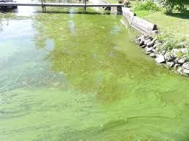

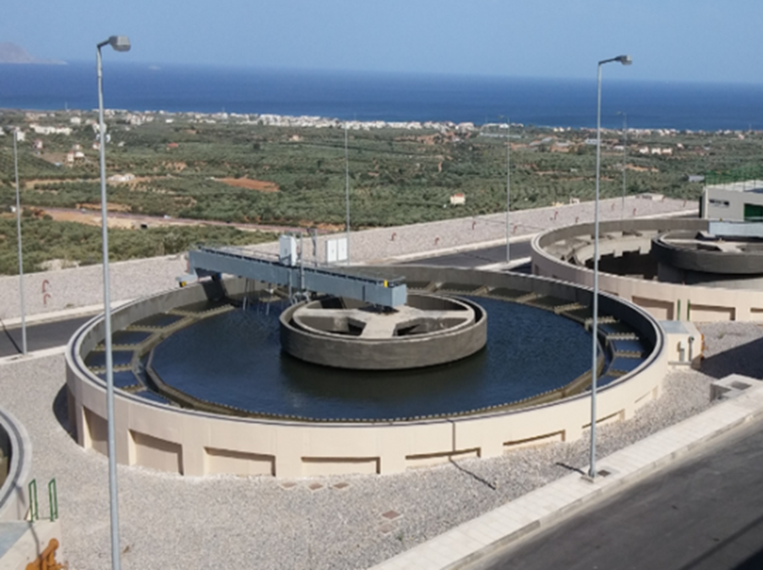
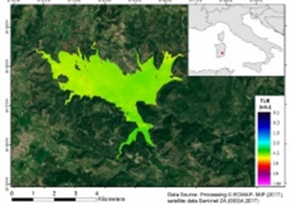
Space Assisted Water Quality Forecasting Platform for Optimized Decision Making in Water Supply Services
The Challenge…
INTEGRATED WATER MANAGEMENT
Policy
context
Public health, environmental & economic concerns
Water Industry challenges
Sustainable performance
Cost efficient operations
Technology
innovation
IWA World Water Congress & Exhibition
19th September 2018
Tokyo, Japan

Slide 3







Space Assisted Water Quality Forecasting Platform for Optimized Decision Making in Water Supply Services
Meet the Partners
IWA World Water Congress & Exhibition
19th September 2018
Tokyo, Japan

Slide 4
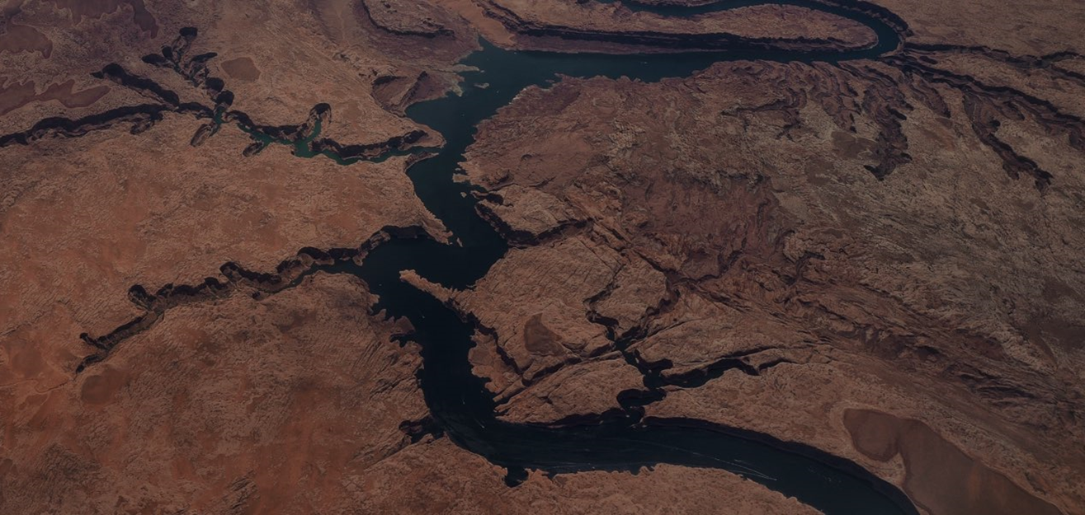
EO data
In situ
New and innovative EO based water quality products…
IWA World Water Congress & Exhibition
19th September 2018
Tokyo, Japan

Slide 5
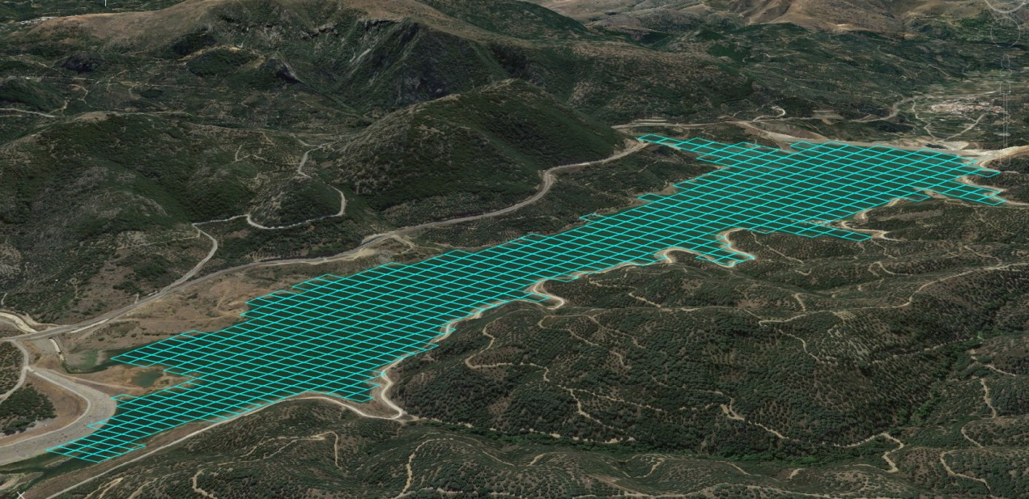
EO data
In situ
Modeling
Forecasting
…and advanced modeling ….
Hydrologic
Hydraulic
Ecological
”Generate water flows and water quality forecasts just like weather”
IWA World Water Congress & Exhibition
19th September 2018
Tokyo, Japan

Slide 6
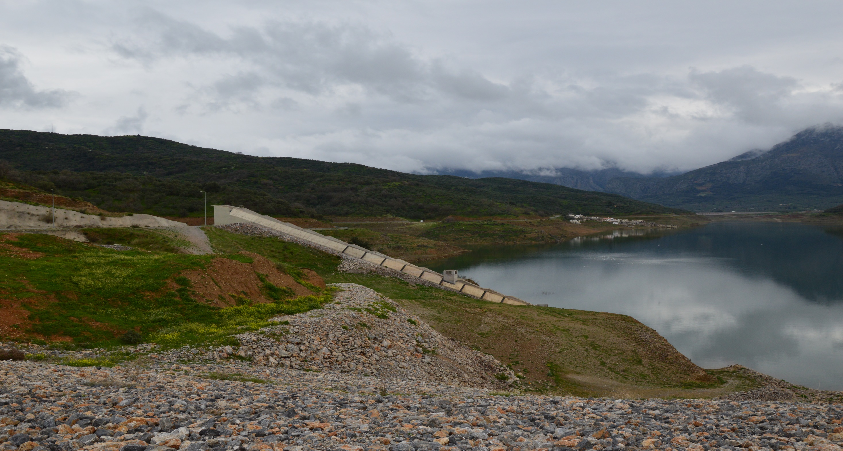
EO data
In situ
Modeling
Forecasting
Decision Support System
Turning disconnected streams of raw data into actionable intelligence and better results
Introducing new EO and upstream modeled forecasting data into Utilities decision making, filling information gaps in space and time
Providing seamless modelling of highly complex and dynamic systems so utilities can create cause-and-effect correlations to guide them in making quick and data-informed decisions increasing their foresight
…to enable adaptive planning and environmental sustainable Reservoir Management for algae and turbidity control ….
Enabling Adaptive Planning: Provide
operational analytics that combine past and current data with predictive simulations to inform complex operational and business decisions.
IWA World Water Congress & Exhibition
19th September 2018
Tokyo, Japan

Slide 7
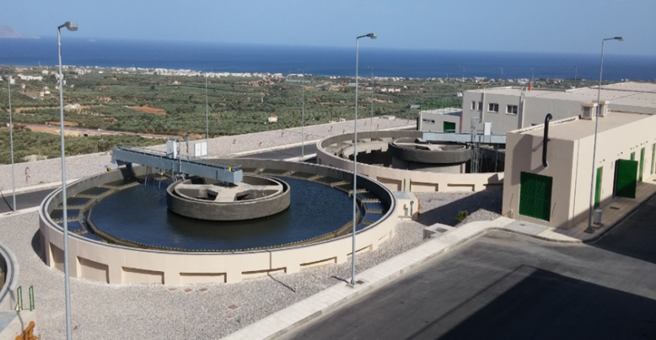
EO data
In situ
Modeling
Forecasting
Decision Support System
…to support cost-effective and environmental sustainable Water Treatment Plants (WTP) operations ….
EO BASED WATER
MONITORING
SHORT TO MEDIUM TERM WATER QUANTITY & QUALITY FORECASTING
EARLY WARNING
Downstream uses
WTP OPTIMIIZATION
Reservoir level
Spatial scale
CITIZENS SCIENCE
RISK ASSESMENT
Catchment level
…Operational service line for the water industry ….
Adding Value Services
Descriptive
Diagnostic
Predictive
Prescriptive
IWA World Water Congress & Exhibition
19th September 2018
Tokyo, Japan

Slide 8
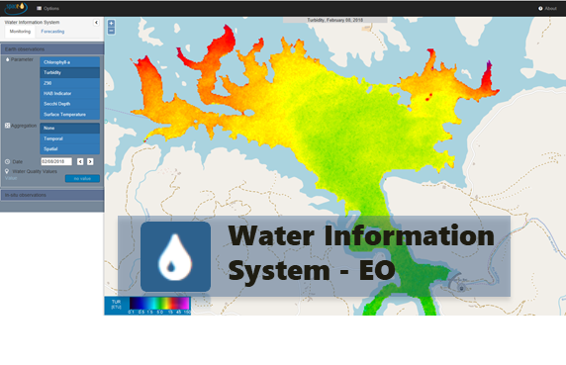
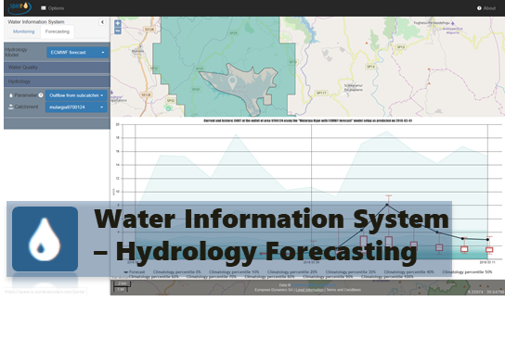
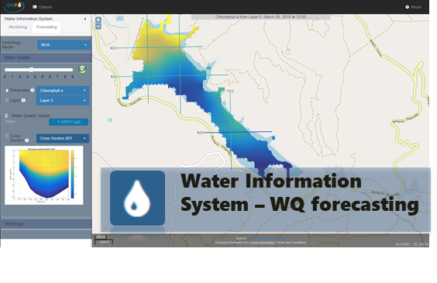
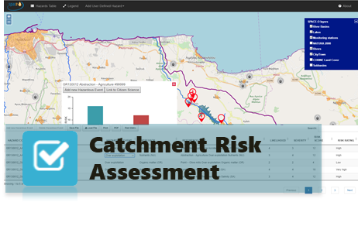
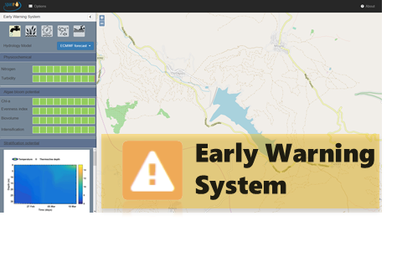
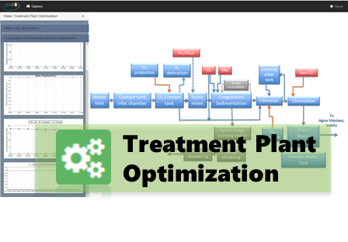
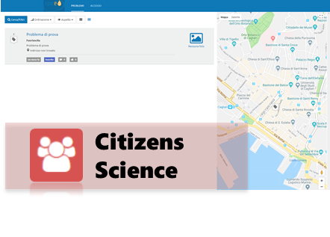
Space Assisted Water Quality Forecasting Platform for Optimized Decision Making in Water Supply Services
SPCACE-O Operational Services …
IWA World Water Congress & Exhibition
19th September 2018
Tokyo, Japan

Slide 9
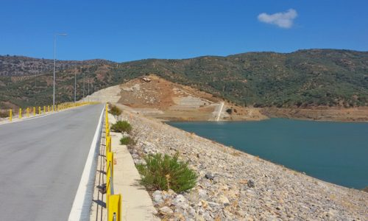
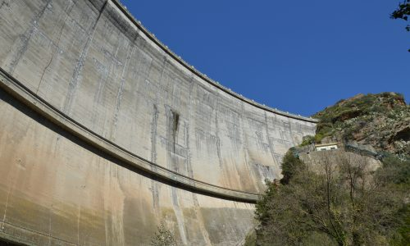


Space Assisted Water Quality Forecasting Platform for Optimized Decision Making in Water Supply Services
Our Show cases…
Organization for the Development of Crete S.A. (OAK S.A.)
Ente Acque della Sardegna (ENAS)
IWA World Water Congress & Exhibition
19th September 2018
Tokyo, Japan

Slide 10

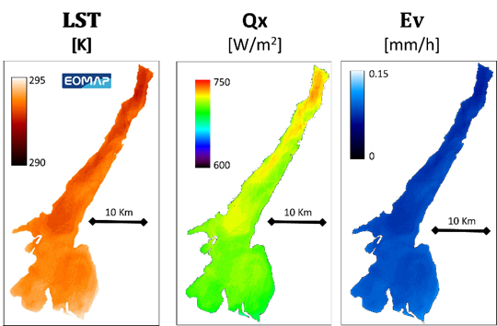
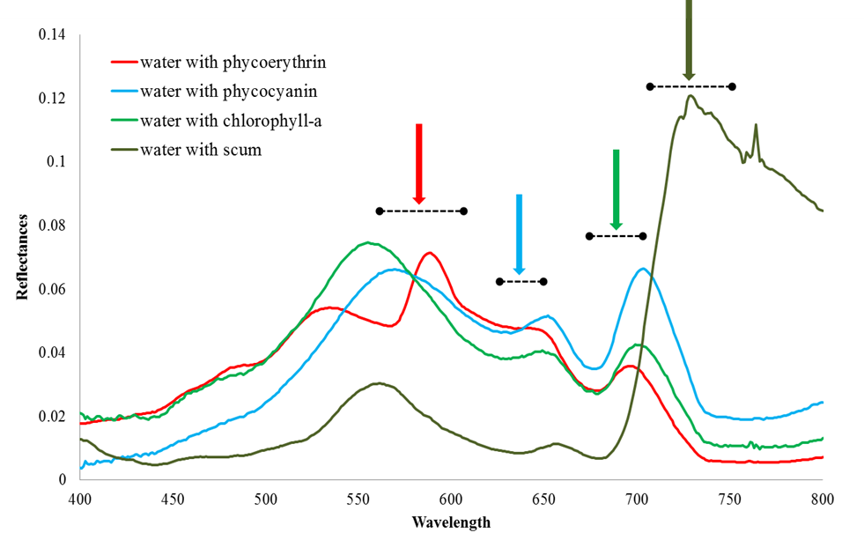

Space Assisted Water Quality Forecasting Platform for Optimized Decision Making in Water Supply Services
The science behind the service…
… improve the physics-based algorithms, providing robust and new EO based products
Integrating satellite images (Sentinel 2&3 –Landsat 8) with field observations (water quality and meteorological data) to set up an index for phytoplankton (cyanobacteria) blooms
IWA World Water Congress & Exhibition
19th September 2018
Tokyo, Japan
Notes:
EO imagery gathered from Landsat-8 and Sentinel-2A/B, along with MERIS, are used within SPACE-O to observe a set of key variables for water quality monitoring. Chlorophyll-a, Turbidity, Secchi Disk Depth and Sea Surface Temperature are used operationally in SPACE-O to support the in-situ monitoring programs of Aposelemis and Mulargia as well as to improve performance of hydrodynamic and water quality models by correcting initial conditions and minimizing error accumulation. EO images have a spatial resolution (pixel size) of 30x30m or 10x10m for Landsat and Sentinel missions respectively. Combining Landsat and Sentinel missions, 2-3 images are available per week on cloud free periods.
Other EO products developed or improved in SPACE-O include 1) hydrological variables (Evaporation, Heat storage, snow cover) which have been used offline for model calibration at scientific case studies 2) Reservoir bathymetry 3) Inorganic and organic suspended matter 4) Water Quality and Trophic state indices and 5) Floating materials (oil, scum, vegetation).

Slide 11
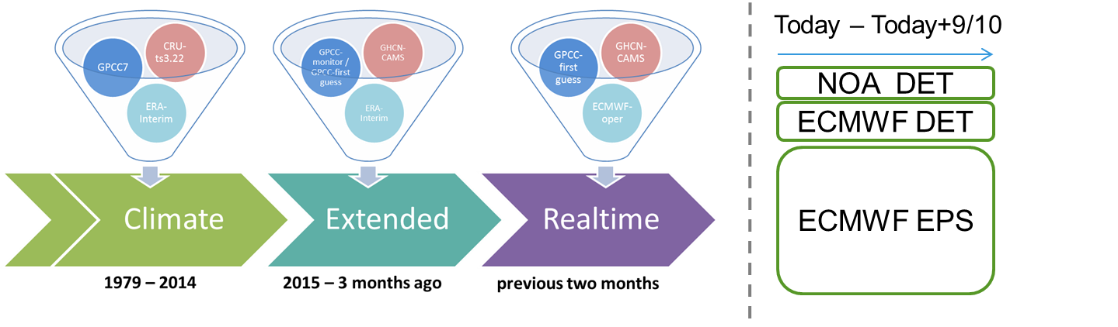
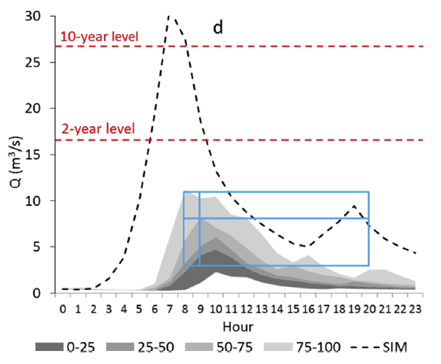
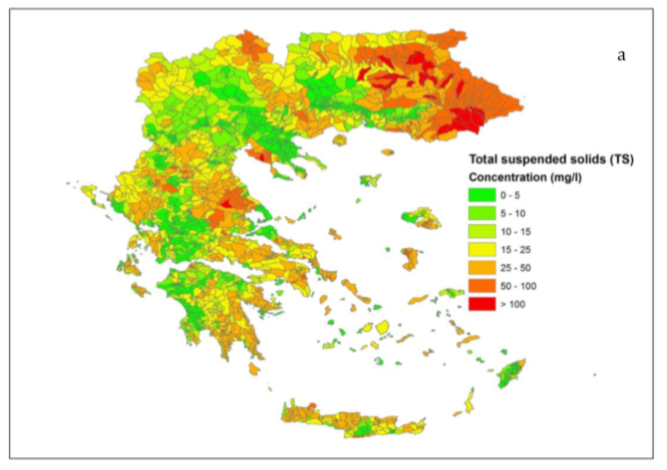
Space Assisted Water Quality Forecasting Platform for Optimized Decision Making in Water Supply Services
The science behind the services…
…integration of almost real-time EO data in the hydrological model, resulting into updated information of the model states and hence potential better forecasts for water quantity.
  ECMWF deterministic and Ensemble Prediction System (EPS) – 51 members
  NOA deterministic (high resolution)
  Discharge
  Water temperature
  Solids (TS & VC)
  Phosphorus (PP & SP)
  Nitrogen (ON & IN)
Short to medium range
IWA World Water Congress & Exhibition
19th September 2018
Tokyo, Japan
Notes:
Hydrological modelling is used to estimate catchments response to meteorological conditions. Using HYPE model run by SMHI we are able to produce operational short-term forecasts river discharges, water temperatures etc for the upstream catchments of the reservoirs for up to 10 days. Meteorological forcing is obtained from ECMWF (European Centre for Medium-Range Weather Forecasts). In Aposelemis case study we are also testing a regional high precision meteorological forcing obtained from NOA (National Observatory of Athens). In SPACE-O a new water quality algorithm has been incorporated in HYPE which allow us to produce forecasts of nutrient (phosphorus and nitrogen) and suspended solids from overland flow that end up in the reservoirs.

Slide 12

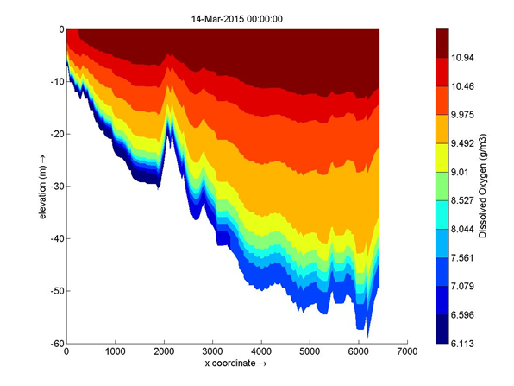
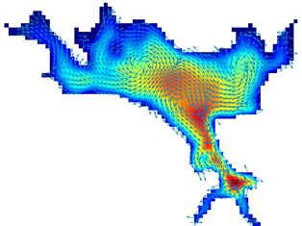
Space Assisted Water Quality Forecasting Platform for Optimized Decision Making in Water Supply Services
The science behind the services…
…Capture the dynamics in a water reservoir with Hydrodynamic and Water quality Modeling
16 state variables
Dissolved oxygen
Suspended inorganic matter
Inorganic dissolved & particulate nutrients
Particulate & dissolved organic matter
Two algal populations
  Capture the motion of water and calculate the forces acting on it
    Water velocities
    Mixing and turbulence
    Water temperature and densities
  Hydrodynamic Simulation
  Water Quality Simulation
50 active processes
Transport
Exchange on the bed-water interface
Primary production
Light extinction
Mineralization processes
Nitrification, denitrification, sorption & desorption
Re-aeration and sediment oxygen demand
IWA World Water Congress & Exhibition
19th September 2018
Tokyo, Japan
Notes:
Hydrological forecasts are in turn forced into the WQ model. We are using a 3D hydrodynamic model (Delft3D-FLOW) to resolve the circulation pattern of the reservoir due to wind & heat stress and momentum exchange across the boundaries of the reservoir, and obtain water levels, velocities and temperatures for the next 10 days.
The results of the hydrodynamic model are then coupled with the water quality model (Delft3D-WAQ) in order to predict the concentrations of key water quality characteristics (algae, inorganic matter, nitrogen, phosphorus, dissolved oxygen, etc) across various depths and areas of interest of the reservoir. In Mulargia we are using a cell size of 75x75 m² with 15 vertical layers, in Aposelemis which is shallower a cell size of 50x50 m² with 10 vertical layers has been used.

Slide 13
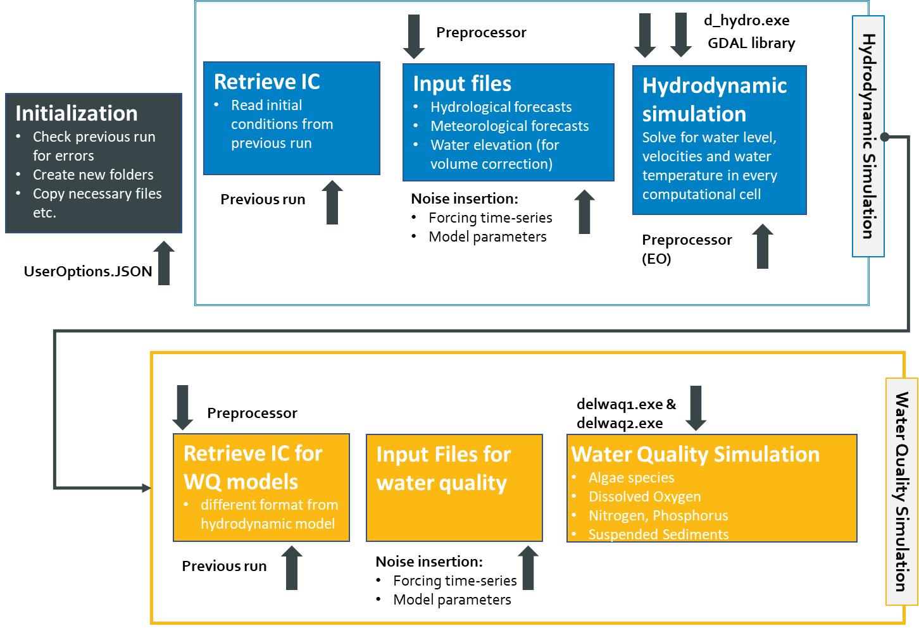
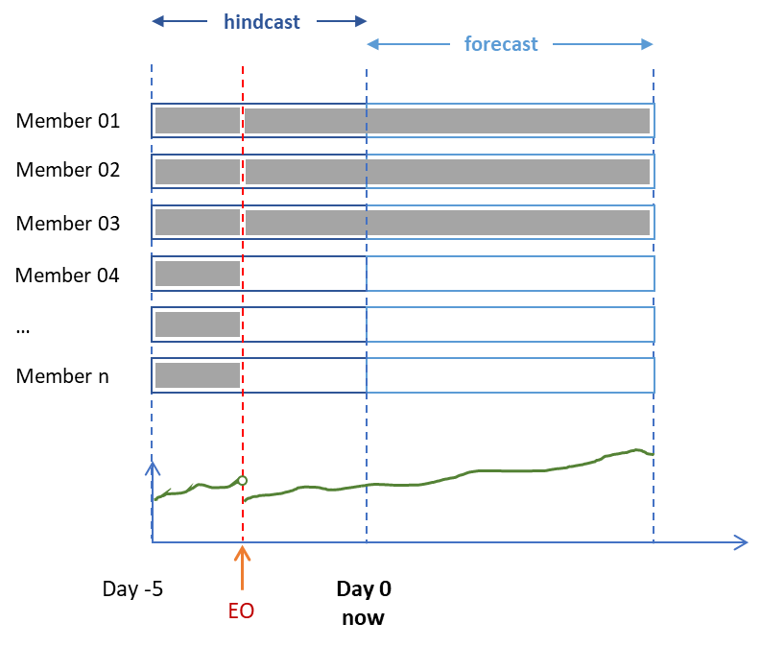
Space Assisted Water Quality Forecasting Platform for Optimized Decision Making in Water Supply Services
The science behind the services…
…real-time EO data assimilation in the WQ Model to improve model performance and operational coupling of HYPE model to hydrodynamic and water quality models in water reservoirs providing near real time, downscaled water quality forecasts
Ensemble Kalman Filter
Operationalization
Up to 10-day forecasts of water levels and key water quality parameters (chlorophyll, sediments, nutrients, dissolved oxygen
IWA World Water Congress & Exhibition
19th September 2018
Tokyo, Japan
Notes:
In real time modelling data assimilation is critical for improving the predictive skill of the models. When EO images of water temperatures are available data assimilation techniques are used to update state variables of the hydrodynamic model. In SPACE-O we have investigated (a) a direct insertion scheme, (b) a weighted average scheme, and (c) an Ensemble Kalman Filter scheme with 15 parallel members.
Similarly EO images of chlorophyll and turbidity are used to correct the state of the water quality model. The correction affects only the surface layers (for which satellites can retrieve information) however it is essential to avoid error accumulation.
Furthermore in both case studies daily water level measurements from in-situ monitoring stations are used to correct the water balance of the reservoir, so that simulated water levels are in agreement with the observed ones.
Hydrological and water quality models including data assimilation are run in a fully automated way and are updated every 24 hours, providing 10 day forecasts for hydrological and wq parameters.

Slide 14









Space Assisted Water Quality Forecasting Platform for Optimized Decision Making in Water Supply Services
The science behind the services…
Machine learning techniques have been developed to simulate the operation of various critical processes (pre-oxidation, ozonation unit, sedimentation – flocculation, filters).
Highly adaptable to WTPs that may deviate from conventional water treatment schemes
Simple with workable computational burden during calibration and forecasting
Out-of-sample extrapolation may be problematic
Machine-learning algorithms are implemented to simulate each process separately
Random Forest model
X
...
Three candidate machine-learning techniques were examined for each stage
of the water treatment process
Stepwise Linear Regression (SLR)
Random Forest (RF)
Y₁
Y₂
Y_{n}
mean response, Y
Gaussian Process Regression (GPR)
IWA World Water Congress & Exhibition
19th September 2018
Tokyo, Japan
Notes:
At the downstream end of the SPACE-O service line, there is the Water Treatment Plant Optimization Tool which uses the water quality forecasts in the reservoir in order to optimize the performance of the Water Treatment Plant, by minimizing chemicals use in the sedimentation-flocculation unit and energy costs of sand filters without compromising effluent water quality.
A series of machine learning techniques has been used to develop credible emulators of various critical processes of the WTP. Machine learning techniques have been preferred over the physical-based models because they are adaptable to the highly complex processes found in conventional water treatment schemes and the are simpler with lower computational requirements.
For each case study and for each treatment stage (pre-oxidation, ozonation, sedimentation-flocculation and filters) three different machine learning techniques have been tested a) Stepwise Linear Regression, b) Random Forest and c) Gaussian Process Regression. The models have been trained with historical operational data from Simbirizzi and Aposelemis plants for the years 2016-2017. The individual models manage to reproduce adequately the performance of the various treatment stages, however longer training periods are necessary to further improve model skill.

Slide 15

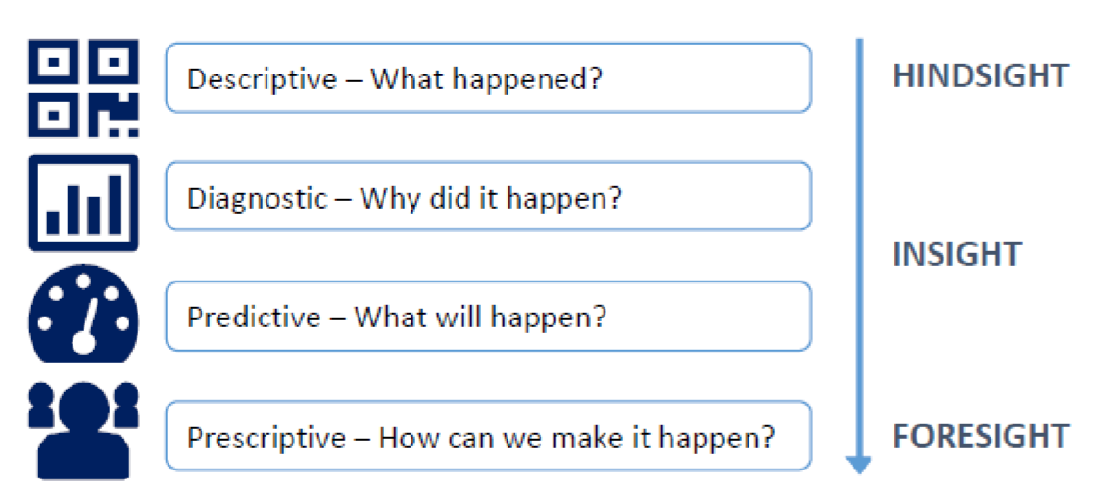
Space Assisted Water Quality Forecasting Platform for Optimized Decision Making in Water Supply Services
Generating Added Value for the Utilities
Building trust with the consumers, offering reputational gains
Turning disconnected streams of raw data into actionable intelligence and better results
Providing opportunities to reduce costs of water treatment, generating both more revenue and higher profit margin
Introducing new EO and upstream modeled forecasting data into Utilities decision making, filling information gaps in space and time
SPACE-O
Value Proposition
Providing Operational Intelligence: Machine learning tools provide insight into operations, enabling clients
to understand and improve the
day-to-day performance of their WTP
Providing seamless modelling of highly
complex and dynamic systems so utilities can create cause-and-effect correlations to guide them in making quick and data-informed decisions increasing their foresight
Enabling Adaptive Planning: Provide
operational analytics that combine past and current data with predictive simulations to inform complex operational and business decisions.
IWA World Water Congress & Exhibition
19th September 2018
Tokyo, Japan

Slide 16
IWA World Water Congress & Exhibition
19th September 2018
Tokyo, Japan

