Slide 1
SPACE-O
Workshop on using Water Quality Forecasting in Decision Making
Singapore, July 10th 2018
Early Warning System
(EWS)
Evangelos ROMAS
EMVIS SA

Slide 2
Early Warning System - EWS
The EWS aims to
interpret forecasts in readily comprehensible warnings that can be coupled with specific action plans
enhance the resilience and the adaptive capacity of water reservoir managers and water utility operators
mitigate of the impact of potentially harmful algae blooms
Keep it simple
Use color scales
Day 1
Day 2
Day 3
Day 9

Slide 3
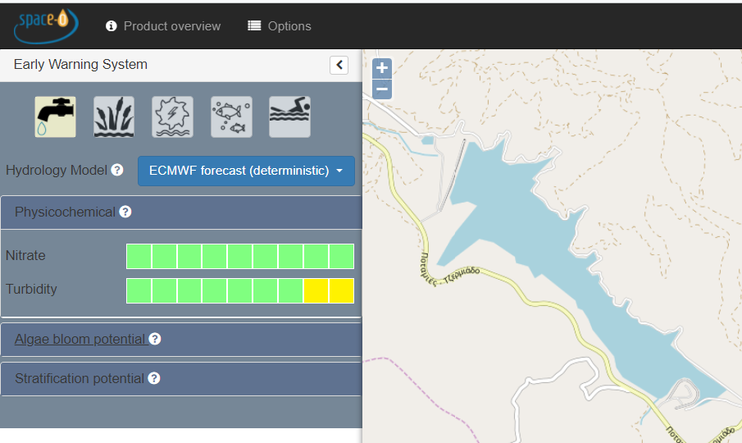
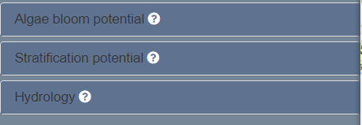



Early Warning System - EWS
Different users
Meteorological forcing
4 types of early warnings are issued
Hydrology
Comparison of river discharges with critical thresholds
Physicochemical parameters
NO₃
Turbidity
Algal bloom potential
Chlorophyll-a
Cyanobacteria biovolume
Evenness index
Bloom intensification index
Stratification and mixing
Thermocline depth
Schmidt stability
Wedderburn and lake numbers

Slide 4
Physicochemical parameters
Nitrate concentrations
Nitrate concentrations are tested against the maximum allowable concentration of 50 mg/l according to the Drinking Water Directive (Council Directive 98/83/EC) on the quality of water intended for human consumption
 | NO₃ remains below 25 mg/l
 | NO₃ exceeds 25 mg/l, but still remains below the maximum allowable concentration of the DWD
 | NO₃ surpasses the maximum allowable concentration of the DWD
Turbidity
Early warnings resonate with the operational standards of the downstream water treatment utilities
Maximum workable turbidity – MWT:
  Turbidity levels that could impede the function of the WTP
  e.g. past-period data for the Simbirizzi WTP in Mulargia indicate that the WTP can cope with raw water turbidities as high as 108 NTU
 | Turbidity remains below the 75% of the MWT limit
 | Turbidity exceeds 75% of the MWT, but is still lower than the MWT limit
 | Turbidity exceeds the MWT limit

Slide 5
Algal bloom potential (1)
Chlorophyll-a (Chlf-a) concentration
Proxy for the overall abundance of algal species
Chlf-a vs. good/moderate (G/M) boundary value and the critical bloom density (CBD) limit for Mediterranean lake types
  G/M and CBD as reported by Mischke et al. (2012) – WISER report on sampling, analysis and counting standards for phytoplankton in lakes
 | Chlf-a is below the G/M boundary value for Mediterranean lake types (i.e. 5.1 μg/l)
 | Chlf-a exceeds the G/M boundary but does not surpass the CBD limit (i.e. 7.7 μg/l)
 | Chlf-a surpasses the CBD limit of 7.7 μg/l
Cyanobacteria biovolume
Cyanobacteria populations vs. low and medium risk levels reported by the World Health Organization
  Low risk = 20,000 cyanobacteria cells/ml
  Medium risk = 100,000 cyanobacteria cells/ml
 | Cyanobacteria biovolume does not exceed the low risk threshold reported by the WHO
 | Cyanobacteria biovolume exceeds the low risk threshold reported by the WHO
 | Cyanobacteria biovolume surpasses the medium risk threshold reported by the WHO

Slide 6

Algal bloom potential (2)
Evenness Index
Estimate of the diversity of algal species calculated from the Shannon diversity index:
where
Presence of a dominant species
0.00
0.25
0.50
0.75
1.00
Even distribution of algal populations
Bloom intensification index
Relative change in cyanobacteria cell density
 | The dissipation of the bloom is likely, i.e. the relative decline of cyanobacteria is greater than 25%.
 | No drastic change is anticipated, i.e. cyanobacteria will not increase or decrease by more than 25%.
 | A further evolution of the bloom is likely, i.e. cyanobacteria will increase by more than 25%.

Slide 7
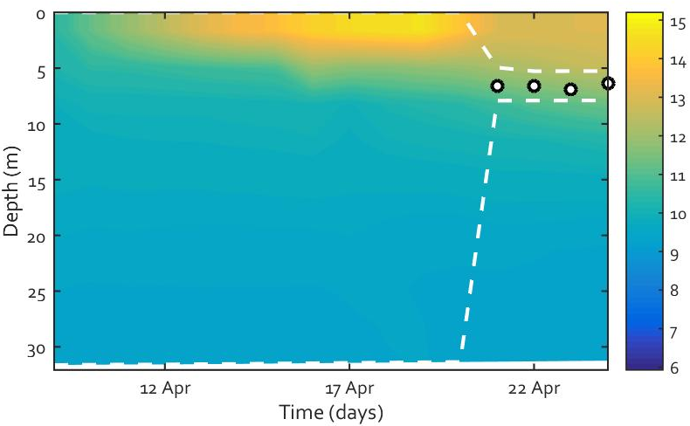

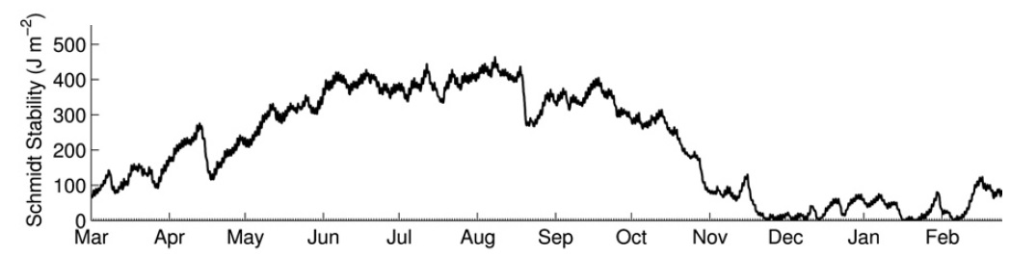

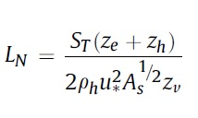
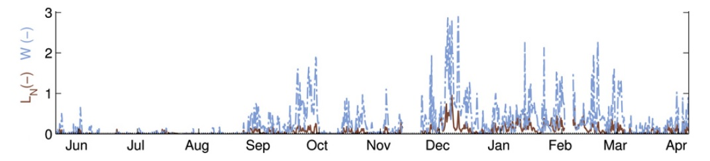
Stratification and mixing
Thermocline depth
Depth of the maximum temperature gradient
Estimate of the width of the mixed surface layer
Resistant to mixing
Schmidt stability, S_{T}
Resistance to mechanical mixing due to the potential energy inherent in the stratification of the water column
Prone to mixing
Wedderburn number, W
Probability of wind-induced upwelling events
W<1 , upwelling events are likely to occur
Lake number, L_{N}
Internal mixing due to wind forcing
Low values = increased vertical mixing

Slide 8
Hydrological Parameters
Comparison of river discharges with critical thresholds for different return periods
Colour | Critical threshold | Description
 | No alert | Forecasted discharge is within normal values (less than 2 years return period). No impact is expected.
 | Alert level 1 | Forecasted discharge exceeds a critical threshold for an event with a return period of > 2 years and < 5 years. No significant impacts are expected.
 | Alert level 2 | Forecasted discharge exceeds a critical threshold for an event with a return period of > 5 years and < 30 years. This is a significant event.
 | Alert level 3 | Forecasted discharge exceeds a critical threshold for an event with a return period of >30 years. This is potentially considered a severe event.

Slide 9
https://portal.space-o.eu/portal/#

